Slide 1
DIGITAL PORTFOLIO
Akshay.P
STUDENT NAME:
REGISTER NO AND NMID:
DEPARTMENT:
COLLEGE/ UNIVERSITY: JCT COLLEGE OF ARTS AND SCIENCE, BHARATHIYAR UNIVERSITY
2422J1160
BCA

Slide 2
SIMPLE PORTFOLIO WEBSITE

Slide 3


AGENDA
Problem Statement
Project Overview
End Users
Tools and Technologies
Portfolio design and Layout
Features and Functionality
Results and Screenshots
Conclusion
Github Link
3/21/2024 Annual Review

Slide 4

PROBLEM STATEMENT
In today’s digital world, students and professionals need an online presence to showcase their skills, academic background, and projects. Without a well-structured portfolio, it becomes difficult to stand out to recruiters, peers, and collaborators.

Slide 5

PROJECT OVERVIEW
This project is a personal portfolio website for Akshay P. It is designed with simplicity, responsiveness, and clarity in mind. The website highlights professional background, personal projects, and provides a direct way for visitors to get in touch.

Slide 6

WHO ARE THE END USERS?
Potential employers and recruiters seeking candidates with skills in AI, Data Science, and Communication.
Academic institutions or peers looking to view project work or professional profile.
Freelance clients or collaborators interested in connecting for projects.

Slide 7

TOOLS AND TECHNIQUES
HTML5 & CSS3 for structure and styling.
Responsive Web Design for mobile/desktop compatibility.
Basic JavaScript for interactivity (dynamic year, form behavior).
UI Techniques like grid layouts, sticky sidebar, and modern typography.

Slide 8
POTFOLIO DESIGN AND LAYOUT
Header: Displays name, department, and college with a bold color scheme.
Profile Section: Contains personal details like name, department, college, address, phone, and email.
Skills Section: Lists key professional and technical skills using a clean, list-based layout.
Contact Section: Provides a direct way for users to get in touch.
Footer: Contains copyright information.
Layout: Simple, responsive, and mobile-friendly design with consistent spacing and shadows for modern aesthetics.
8

Slide 9
FEATURES AND FUNCTIONALITY
Clean, readable typography for easy navigation.
List-based skill showcase with visual separation using borders and background colors.
Clickable email links for immediate contact.
Responsive design ensures usability on desktop and mobile devices.
Lightweight, fast-loading portfolio suitable for sharing online.

Slide 10
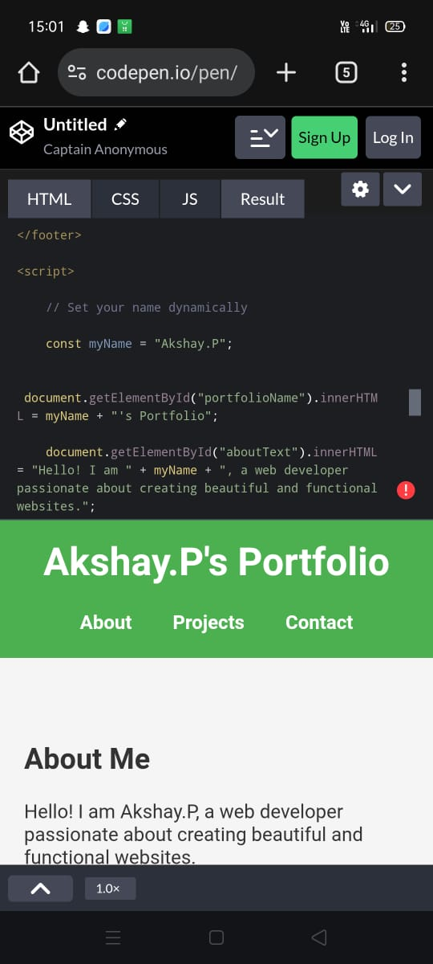

RESULTS AND SCREENSHOTS
3/21/2024 Annual Review
10

Slide 11
CONCLUSION
The portfolio website is a practical, user-friendly, and professional platform for presenting personal achievements and technical projects. It demonstrates core front-end skills while providing a foundation that can be expanded with advanced features like animations, backend integration, or a blog.
11

